Slide 1


Developing Energy Efficiency and Cost Projections of Future Building Technologies for NEMS
Ed Barbour
Navigant Consulting, Inc
1801 K Street
Washington D.C.
March 18, 2003

Slide 2
Agenda
Introduction
Technology Based
Cost Estimates
Example

Slide 3
Agenda
Introduction
Technology Based
Cost Estimates
Example

Slide 4
Navigant Consulting, previously Arthur D. Little, has helped EIA develop performance/cost characteristics for Building Equipment.
Introduction
Last analysis created a 2000 baseline
  Review of literature, standards, installed base, contractor, and manufacturer information
Forecast of technology improvements that will become available over the next twenty years
  Review of trends in standards, product enhancements, R&D
  Projected impact of product improvements and enhancement to technology
  Estimated costs and volume of these improvements
The performance/cost characterization of end-use equipment developed assists EIA in projecting national primary energy consumption.

Slide 5
Input from government, R&D organizations, and manufacturers, was used to project product enhancements concerning equipment performance and cost attributes.
Introduction
Varied sources ensure a balanced view of technology progress and the probable timing of commercial availability.
Technology developments impact performance and cost forecasts.
Technology forecasting involves many uncertainties.
In general, projections were made assuming that more efficient, potentially available technologies penetrated the market from 2005 to 2020 through evaluating:
Economies of production
Established sales and distribution network

Slide 6
The scenarios examined in developing performance/cost characteristics include incremental (reference case) and advanced (high tech case) adoption.
Introduction
Below are definitions for the terms used in characterizing the status of each technology.
  2000 Current Standard: the minimum efficiency required by current standards.
  Typical: average product being sold in the particular timeframe.
  High: the product with the highest efficiency available in the particular timeframe.

Slide 7
Agenda
Introduction
Industry/Technology Based
Cost Estimates
Example

Slide 8
By working with manufacturers and vendors, as well as the many previous technology studies for DOE, we can begin to develop equipment characteristics.
Methodology Data Sources
New equipment characteristics
Description/Assumption
Data Sources
Typical Capacity
Size of equipment, units vary by equipment type
Interviews with installers, distributors, GAMA, ARI, AHAM
Equipment cost
Retail cost of equipment
Interviews with installers, distributors, Current Industrial Reports, Trade Associations
Installation cost
Cost of equipment installation, materials and labor
Interviews with installers, distributors, Current Industrial Reports, Trade Associations
Maintenance and operations cost
Cost of preventive maintenance and annualized repair costs
Interviews with installers, distributors, Current Industrial Reports, Trade Associations
Efficiency
Efficiency of equipment, units vary by equipment type
Product literature, ARI,GAMA, AHAM

Slide 9
Developing cost data for building equipment often relies on varying degrees of product cost knowledge
Methodology Economies of Production
8
Understand how process
and product design impacts
product cost
7
Know key product cost drivers
6
Have firm “quote” from supplier for
specific volumes
Obtain “estimate” from suppliers
5
Product Cost Knowledge
Internal estimate based on previous
experience with similar products
4
3
Educated guess based on materials
weights, rules of thumb, etc.
2
Wild guess
1
No product cost information
Evolution

Slide 10
We use product-based cost models to establish baseline costs and evaluate alternative product concept or design variations.
Methodology Economies of Production
Cost Model Elements
  Assembly hierarchy
  “Structured” BOM
  Direct material costs
  Fabrication and assembly times associated with each component/sub-assembly
Final Assembly
Final Functional
Test-Sampling
Final Inspection
Painting
Attach Additional
Components
Heat Treating
Other Connections
Overall Structure
Subassembly 2
Subassembly 4
Auxiliary Components
Subassembly 1
Subassembly 3
Subassembly 5
Fabrication and Sub-Sub Assembly Processes

Slide 11
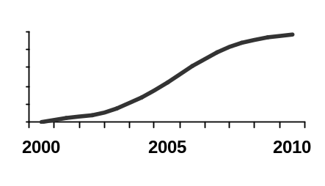
Analysis of available products begins with bottoms-up building data uses a systematic screening process determine the likely size of the market, hence volume and potential price.
Methodology Established sales and distribution network
Technical Market Potential
Existing building stock for retrofit and new construction
Product Characteristics
(size, fuel, etc.)
Accessible Market Potential
Product Performance
versus Alternatives
Ultimate Market Penetration
Annual Sales Over Time
New Product Adoption Rates

Slide 12
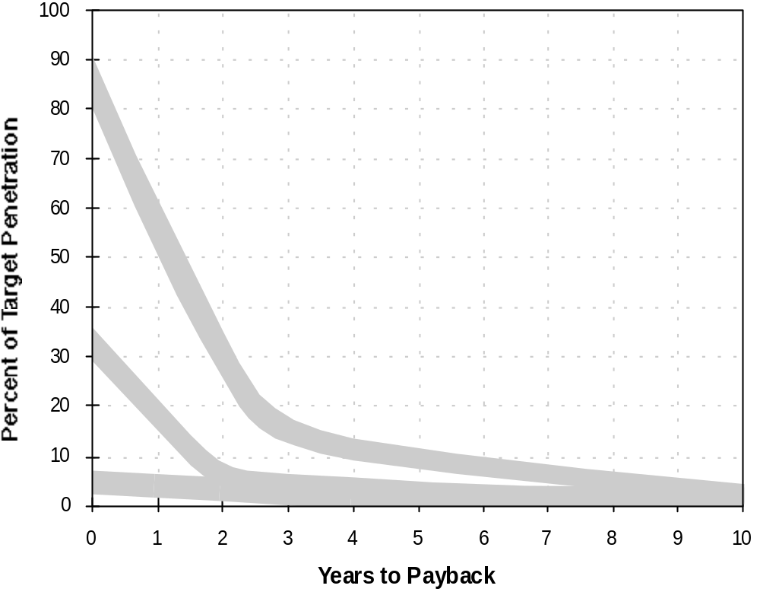

Market penetration for a new technology can also be estimated based on payback analysis, as illustrated here for energy technologies deployed in commercial buildings.
Methodology Established sales and distribution network
Impact of Payback Period on Market Penetration for HVAC Equipment
Ultimate Adoption
(>10 Years Following Commercial Viability)
Five Years Following Commercial Viability
Lease/Rental
One Year Following Commercial Viability
Percent of Maximum Penetration
Owner Occupied/
Institutional
Third Party/Utility
Notes:
This slide illustrates two approaches ADL has taken in the past in estimating market penetration. The rate at which a new technology can enter the market and take market share away from existing technologies is a strong function of economics.
On the left the typical market penetration curve illustrates how market share increases as a technology passes from one stage to another, following a typical “S-Curve”.
The slope of this curve will depend of economics and the ability of the manufacturer to exploit unique attributes of the technology.
The figure on the right shows ADL’s estimates of expected market penetration based on payback period for building HVAC systems.
Generally, longer payback period result in lower ultimate adoption rates.

Slide 13
Agenda
Introduction
Technology Based
Cost Estimates
Example

Slide 14
Below are the estimates in performance/cost for residential water heaters in 2005.
Performance/Cost Characteristics Residential Water Heaters
Gas-Fired
Electric
Heat Pump
Solar
Typical
High
Typical
High
Typical
High
Typical
Typical Capacity (gal)
40
50
52
52
52
52
Typical Capacity (sq. ft)
40
Energy Factor
0.60
0.86
0.90
0.95
2.0
2.6
Overall
Efficiencies
50% of Water Heating Load
Average Life (yrs)
9
20
14
14
12
12
Average Life
(yrs)
20
Retail Equip. Cost
$200-
$250
$1,500
$240-
$260
$300-
$400
$975
$750
Retail Equip.
Cost
$1,700-$2,000
Total Installed Cost
$380
-$400
$2,000
$480-
$500
$420-$450
$1,175
$1,100
Total Installed Cost¹
$2,200-$3,200
Annual O&M Cost
$50
$50
$50
$50
$75
$75
Annual O&M
Cost
Negligible
¹These product costs for an active, indirect or closed loop system; include tank and back-up system.

Slide 15
Each estimate is based on the best available information on the future technology and market.
Performance/Cost Characteristics Residential Water Heaters
Gas-Fired
Gas-Fired: The new federal standard coming into effect in January 2004 will have an EF of 0.59 for a 40-gallon water heater.
Additionally, costs have been added in the out years (2005 and beyond) to account for new flammable vapor resistant designs and a new blowing agent for the insulating foam used in the water heaters.
Typical
High
Typical Capacity (gal)
40
50
Energy Factor
0.60
0.86
Average Life (yrs)
9
20
Retail Equip. Cost
$200-
$250
$1,500
Total Installed Cost
$380
-$400
$2,000
Annual O&M Cost
$50
$50

Slide 16
Each estimate is based on the best available information on the future technology and market.
Performance/Cost Characteristics Residential Water Heaters
Electric
Electric Resistance: The new standard coming into effect in January 2004 will have an EF of 0.90 for a 52-gallon water heater.
Costs have been added in the out years (2005 and beyond) to account for a new blowing agent for the insulating foam used in the water heaters.
The highest efficiency electric resistance water heater is not likely to see any efficiency improvement due to thermal limits and diminishing returns on controlling heat loss.
Typical
High
Typical Capacity (gal)
52
52
Energy Factor
0.90
0.95
Average Life (yrs)
14
14
Retail Equip. Cost
$240-
$260
$300-
$400
Total Installed Cost
$480-
$500
$420-$450
Annual O&M Cost
$50
$50

Slide 17
Advanced/potential future technologies look at the current research and development being conducted.
Performance/Cost Characteristics Residential Water Heaters
Heat Pump
Since 1990, heat pump water heater (HPWH) technology has advanced in efficiency and has been reduced in capacity to reduce cost.
However, the high first cost still precludes a large market penetration.
The future 2.0 EF HPWH assumes a smaller compressor with 40% less heating capacity than any used in existing heat pump water heater products (and with about 25% of the heating capacity of a typical electric resistance hot water heater), leading to reduced cost at a lower EF. This product is currently under development by DOE.
Typical
High
Typical Capacity (gal)
52
52
Energy Factor
2.0
2.6
Average Life (yrs)
12
12
Retail Equip. Cost
$975
$750
Total Installed Cost
$1,175
$1,100
Annual O&M Cost
$75
$75

Slide 18
Advanced/potential future technologies look at the current research and development being conducted.
Performance/Cost Characteristics Residential Water Heaters
Solar
The typical annual efficiency (35-40%) of the Solar Water Heating (SWH) system (thermal output divided by solar input) will vary significantly depending on location.
The typical collector area of 40 ft² is based on systems in the Southern and Western U.S. where the majority of SWH systems are installed. Colder areas such as Wisconsin would use 64 ft² collector and a secondary water/glycol heating loop.
These installed costs are for systems in a Southern climate. An equivalent system installed in the Northeast would cost $3,500-$4,000, due to the requirements for freeze protection and additional collector area. Costs vary widely depending on collector quality and type of system.
The retail cost for 40 square feet flat plate collectors is in the $750-$950 range.
Typical
Typical Capacity (sq. ft)
40
Overall
Efficiencies
50% of Water Heating Load
Average Life
(yrs)
20
Retail Equip.
Cost
$1,700-$2,000
Total Installed Cost¹
$2,200-$3,200
Annual O&M
Cost
Negligible

Slide 19
An example of a typical data sheet (for Residential Electric Resistance Water Heater)
Performance/Cost Characteristics Residential Electric Resistance Water Heaters
1999
2000
2000
2005
2010
2020
Installed
Base
Current Standard
Low
Typical
High
Typical
High
Typical
High
Typical
High
Typical Capacity
(gal)
52
52
52
52
52
52
52
52
52
52
52
Energy Factor
0.83
0.86
0.86
0.88
0.95
0.90
0.95
0.90
0.95
0.90
0.95
Average Life (yrs)
14
14
14
14
14
14
14
14
14
14
14
Retail Equip. Cost
$182
$182
$182
$182
$350-
$450
$240-
$260
$300-
$400
$240-
$260
$300-
$400
$240-
$260
$300-
$400
Total Installed Cost
$337
$337
$337
$337
$470-$490
$480-
$500
$420-$450
$480-
$500
$420-$450
$480-
$500
$420-$450
Annual O&M Cost
$50
$50
$50
$50
$50
$50
$50
$50
$50
$50
$50

Slide 20
A total of 31 technologies were evaluated as part of the study.
Performance/Cost Characteristics Conclusions: Study’s Contents
Residential Gas-Fired Water Heaters
Residential Electric Resistance Water Heaters
Residential Heat Pump Water Heaters
Residential Solar Water Heaters
Residential Gas-Fired Furnaces
Residential Hydronic Heating System (Boilers)
Residential Room A/C
Residential Central A/C
Residential Air Source Heat Pumps
Residential Ground Source Heat Pumps
Residential Gas Heat Pumps
Residential Refrigerator/Freezer
Residential Cooktops and Stoves (Gas)
Residential Clothes Washers
Residential Dishwashers
Commercial Centrifugal Chillers
Commercial Gas-Fired Chillers (Water Cooled)
Commercial Reciprocating Chillers
Commercial Rooftop Units (A/C Units)
Commercial Gas-Fired Furnaces
Commercial Electric Boilers
Commercial Gas-Fired Boilers
Commercial Oil-Fired Boilers
Commercial Gas Water Heaters
Commercial Electric Resistance Water Heaters
Commercial Booster Water Heaters
Commercial Gas-Fired Instantaneous Water Heaters
Commercial Rooftop Heat Pumps
Commercial Natural Gas-Fired Engine-Driven Rooftop A/C
Commercial Office Equipment
Commercial Fuel Cells

